Slide 1
Lab 6 Laplace Transform

Slide 2
Objective
Laplace transform and inverse Laplace transform.
Poles and zeroes of a system and the effect.
Application in system analysis.

Slide 3
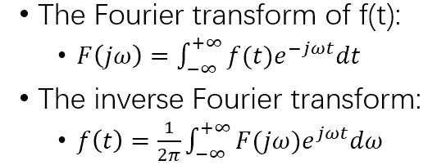
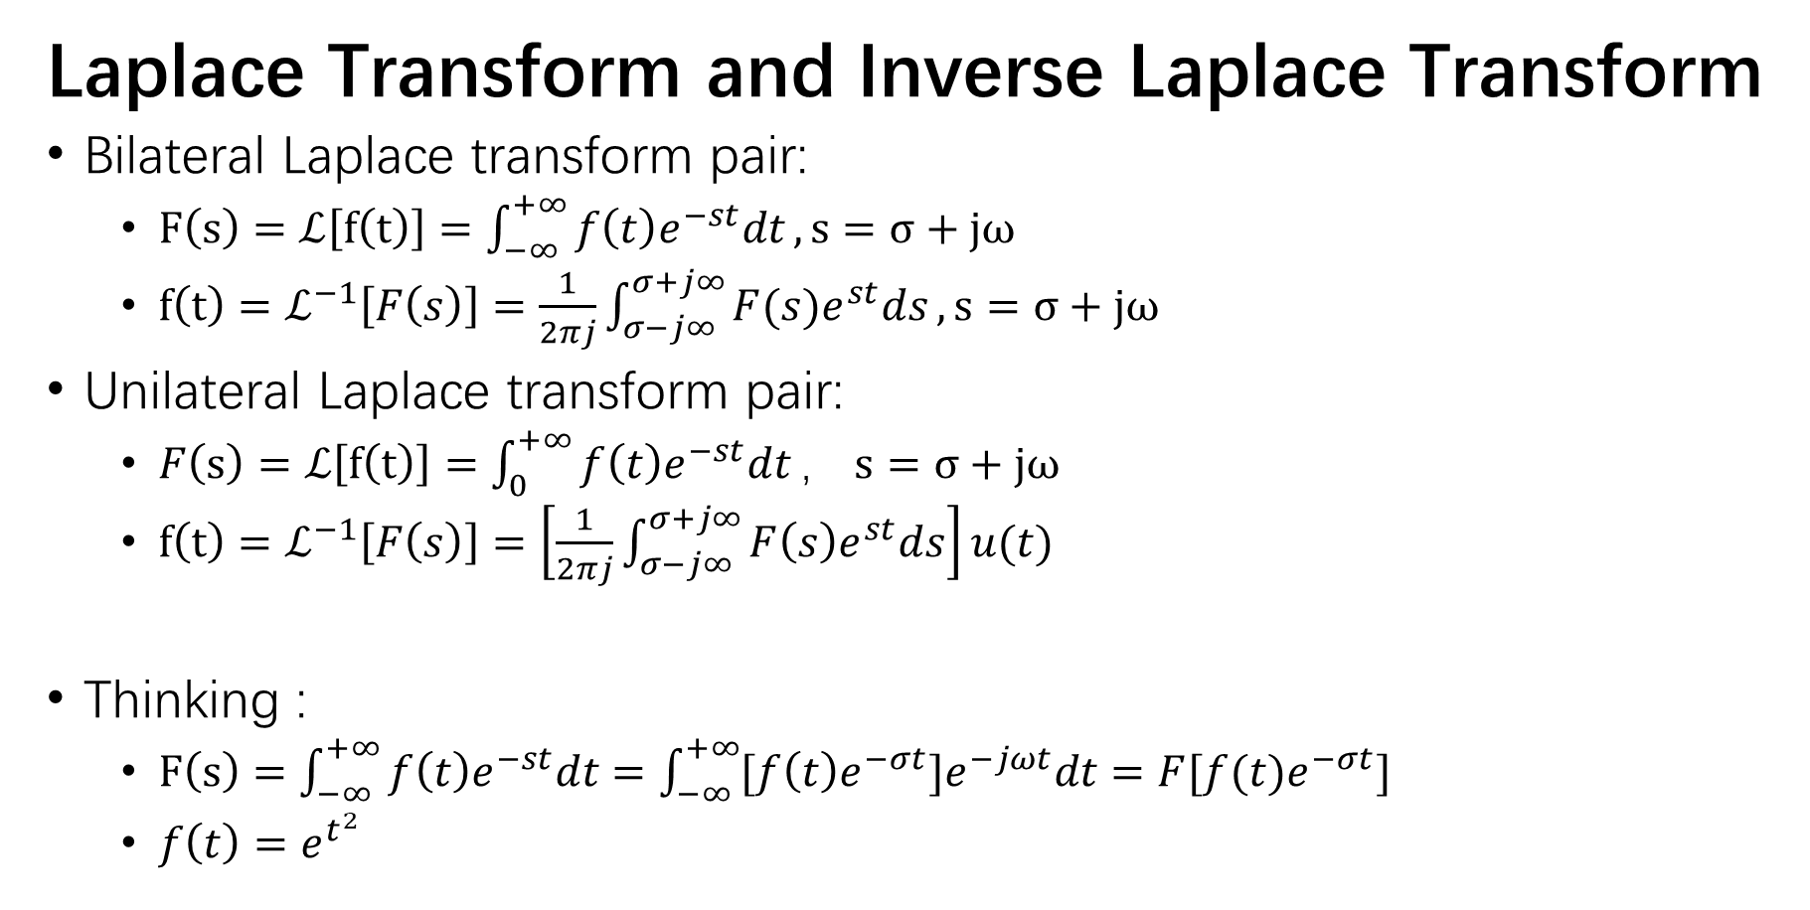
Laplace Transform and Inverse Laplace Transform
Bilateral Laplace transform pair:
$F\left(s\right)=ℒ\left[f\left(t\right)\right]=\int_{−∞}^{+∞}{f\left(t\right)e^{−st}dt}, s=σ+jω$
$f\left(t\right)=ℒ^{−1}\left[F\left(s\right)\right]=\frac{1}{2πj}\int_{σ−j∞}^{σ+j∞}{F(s)e^{st}ds}, s=σ+jω$
Unilateral Laplace transform pair:
$F\left(s\right)=ℒ\left[f\left(t\right)\right]=\int_{0}^{+∞}{f\left(t\right)e^{−st}dt}， s=σ+jω$
$f\left(t\right)=ℒ^{−1}\left[F\left(s\right)\right]=\left[\frac{1}{2πj}\int_{σ−j∞}^{σ+j∞}{F\left(s\right)e^{st}ds}\right]u(t)$
Thinking :
$F\left(s\right)=\int_{−∞}^{+∞}{f\left(t\right)e^{−st}dt}=\int_{−∞}^{+∞}{[f\left(t\right)e^{−σt}]e^{−jωt}dt}=F[f(t)e^{−σt}]$
$f\left(t\right)=e^{t^{2}}$

Slide 4
e.g.
Laplace Transform and Inverse Laplace Transform
Laplace transform
laplace(f)
laplace(f, transVar)
laplace(f, var, transVar)
Inverse Laplace transform
ilaplace(F)
ilaplace(f, transVar)
ilaplace(f. var, transVar)

Slide 5
e.g.
Poles and Zeros
The characteristics of system impulse response (h(t)) in time domain.
The stability of the system.
The frequency characteristics (H(jw)).
Function
pole(sys)
zero(sys)
pzplot(sys)/pzpmap(sys)
sys = tf(num, den)

Slide 6
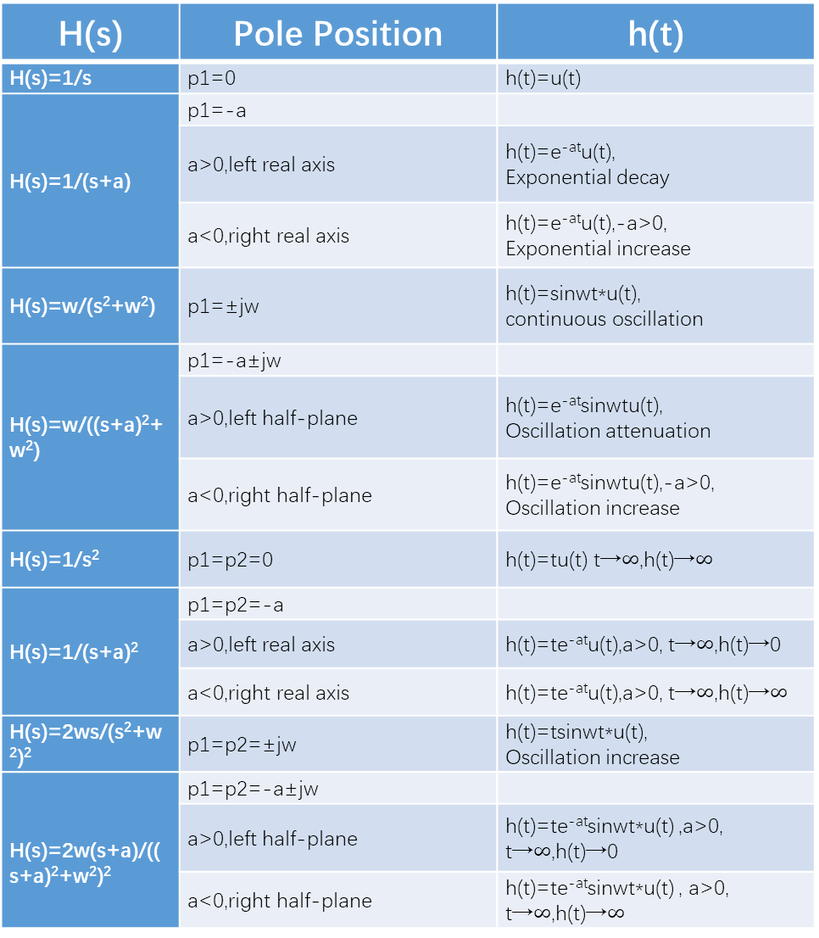
H(s) | Pole Position | h(t)
H(s)=1/s | p1=0 | h(t)=u(t)
H(s)=1/(s+a) | p1=-a
 | a>0,left real axis | h(t)=e^{-at}u(t), Exponential decay
 | a<0,right real axis | h(t)=e^{-at}u(t),-a>0, Exponential increase
H(s)=w/(s²+w²) | p1=±jw | h(t)=sinwt*u(t), continuous oscillation
H(s)=w/((s+a)²+w²) | p1=-a±jw
 | a>0,left half-plane | h(t)=e^{-at}sinwtu(t), Oscillation attenuation
 | a<0,right half-plane | h(t)=e^{-at}sinwtu(t),-a>0, Oscillation increase
H(s)=1/s² | p1=p2=0 | h(t)=tu(t) t→$∞$,h(t)→$∞$
H(s)=1/(s+a)² | p1=p2=-a
 | a>0,left real axis | h(t)=te^{-at}u(t),a>0, t→$∞$,h(t)→0
 | a<0,right real axis | h(t)=te^{-at}u(t),a>0, t→$∞$,h(t)→$∞$
H(s)=2ws/(s²+w²)² | p1=p2=±jw | h(t)=tsinwt*u(t), Oscillation increase
H(s)=2w(s+a)/((s+a)²+w²)² | p1=p2=-a±jw
 | a>0,left half-plane | h(t)=te^{-at}sinwt*u(t) ,a>0, t→$∞$,h(t)→0
 | a<0,right half-plane | h(t)=te^{-at}sinwt*u(t) , a>0, t→$∞$,h(t)→$∞$
Poles and h(t)

Slide 7
Poles and Zeros

Slide 8

System Analysis-Difference Equations
$\left\{\begin{aligned}y^{′′}\left(t\right)+3y^{′}\left(t\right)+2y\left(t\right)=f\left(t\right),f\left(t\right)=e^{−t}u\left(t\right) \\ {y\left(0_{−}\right)=1，y}^{′}\left(0_{−}\right)=2\end{aligned}\right.$
[$s^{2}Y\left(s\right)−sy\left(0_{−}\right)−y^{′}\left(0_{−}\right)]+3∙\left[sY\left(s\right)−y\left(0_{−}\right)\right]+2Y\left(s\right)=F(s)$
${Y\left(s\right)∙[s}^{2}+3s+2]+[−sy\left(0_{−}\right)−y^{′}\left(0_{−}\right)−3y\left(0_{−}\right)]=F(s)$

Slide 9

System Analysis-Difference Equations
$Y\left(s\right)=\frac{s+5}{s^{2}+3s+2}+\frac{1}{s^{2}+3s+2}∙\frac{1}{s+1}=\left[\frac{−3}{s+2}+\frac{4}{s+3}\right]+\left[\frac{1}{{(s+1)}^{2}}+\frac{−1}{s+1}+\frac{1}{s+2}\right]$
$y\left(t\right)=\left[−3e^{−2t}+4e^{−3t}\right]+[te^{−t}−e^{−t}+e^{−2t}]$

Slide 10
System Analysis-Circuits
$u\left(t\right)=R∙i\left(t\right)⟹ℒ[u\left(t\right)]=ℒ[R∙i\left(t\right)]⟹\frac{U(s)}{I(s)}=R$

Slide 11
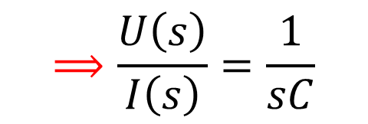

System Analysis-Circuits
$i\left(t\right)=C\frac{du\left(t\right)}{dt}⟹ℒ[i(t)]=ℒ[C\frac{du\left(t\right)}{dt}]⟹I\left(s\right)=C\left[sU\left(s\right)−u\left(0_{−}\right)\right]$
$$⟹I\left(s\right)=CsU\left(s\right)$$
$$⟹\frac{U\left(s\right)}{I\left(s\right)}=\frac{1}{sC}$$

Slide 12
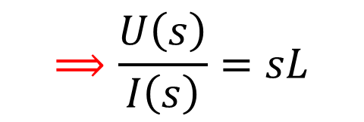

System Analysis-Circuits
$u\left(t\right)=L\frac{di\left(t\right)}{dt}⟹ℒ[u(t)]=ℒ[L\frac{di\left(t\right)}{dt}]⟹U\left(s\right)=L[sI\left(s\right)−i(0_{−})]$
$$⟹U\left(s\right)=LsI\left(s\right)$$
$$⟹\frac{U\left(s\right)}{I\left(s\right)}=sL$$

Slide 13
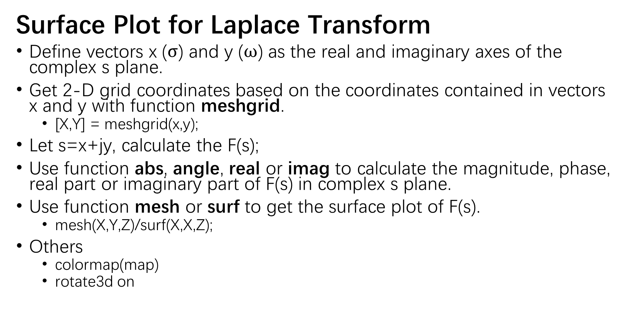
e.g.
Surface Plot for Laplace Transform
Define vectors x ($σ$) and y ($ω$) as the real and imaginary axes of the complex s plane.
Get 2-D grid coordinates based on the coordinates contained in vectors x and y with function meshgrid.
[X,Y] = meshgrid(x,y);
Let s=x+jy, calculate the F(s);
Use function abs, angle, real or imag to calculate the magnitude, phase, real part or imaginary part of F(s) in complex s plane.
Use function mesh or surf to get the surface plot of F(s).
mesh(X,Y,Z)/surf(X,X,Z);
Others
colormap(map)
rotate3d on

Slide 14
e.g.
Relationship between Lapalce and Fourier
Think about it.

